Slide 1
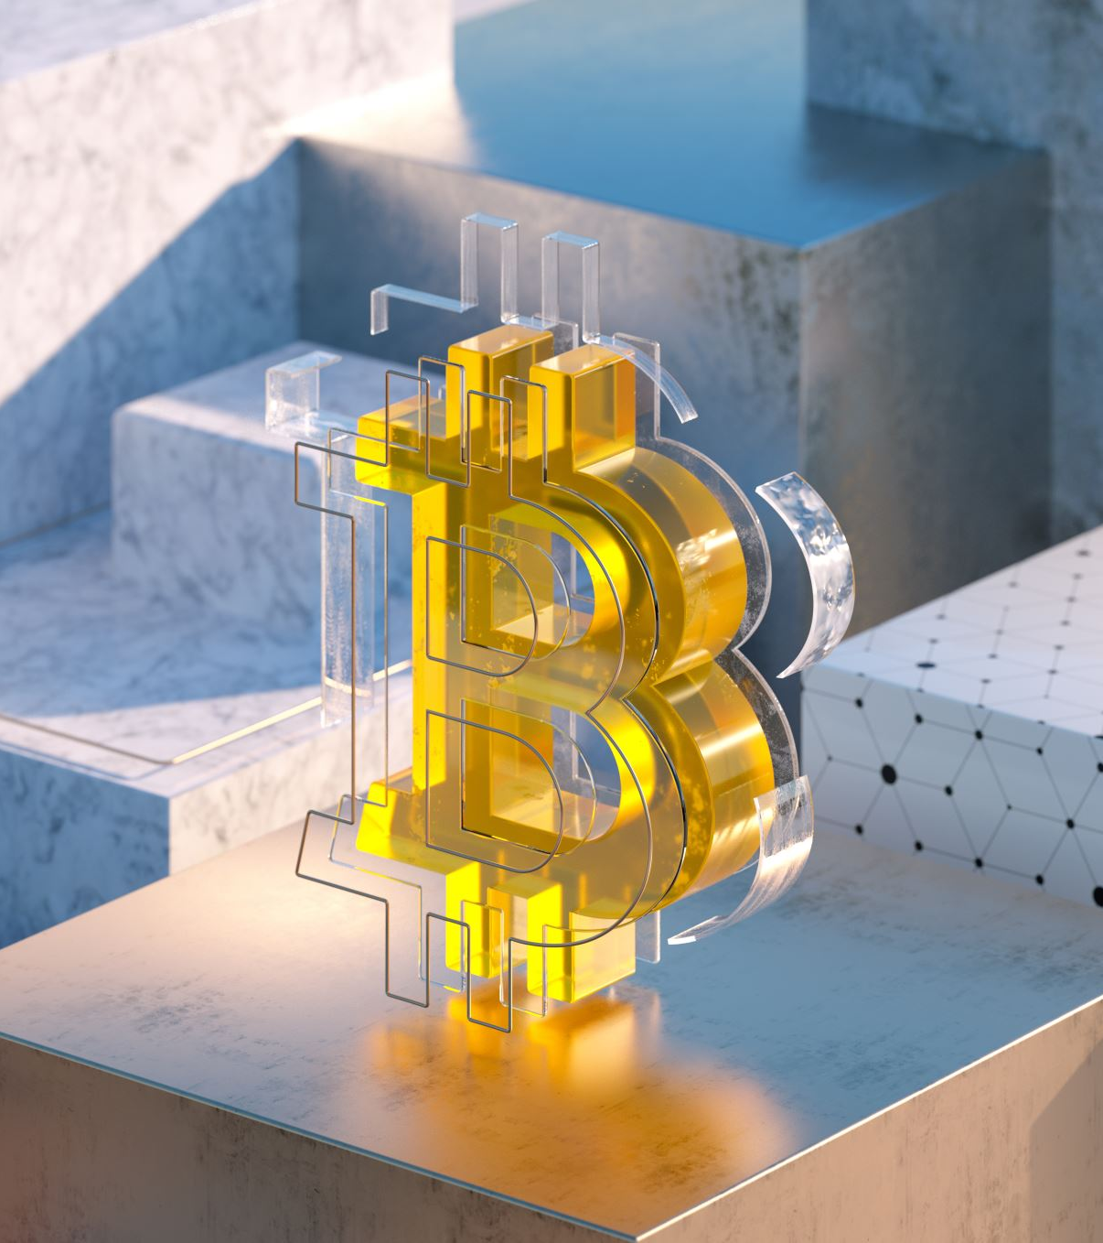
BITCOIN
Introduction
Part 1: The money problem
Howard Minor

Slide 2
Explore the fundamental purpose of money and why it is necessary
1
Identify and examine each of the core properties of money
2
Identify and discuss the difference between GOOD and BAD money
3
GOALS FOR THE DAY

Slide 3
Barter and Trade
Without money, we resort to barter/trade is not efficient, especially at a large scale. Too difficult to relate the value of a chicken to a haircut, to a shirt, to a car.
Money is a technology that is designed to solve the problem of communicating relative value. It functions as a technological device which allows us to compare the value of everything back to the same universal standard.
It’s important to think of money as a common denominator. It’s essentially a universally agreed way we use to measure economic value.
Money effectively becomes a shared language that everyone agrees with and uses to communicate what something is “worth”.

Slide 4
WHAT IS MONEY?
Money also serves as compensation of our work effort.
We provide a service, do a job, produce a product, innovate, create, and for that effort we create value to other humans in our community.
Therefore, we get paid in “money” as a way to store our earned economic energy so we can use it later when we need to exchange it for something else.

Slide 5
WHAT IS MONEY?
Throughout history, humans have tried many different forms of money to solve the fundamental barter problem.
Humans have been known to use beads, shells, rocks, feathers, even salt. Eventually we started using certain metals like gold or silver usually in the form of coins or bars.
We currently use something called dollars. Whenever you hear the word “money”, that’s probably what you think of since that is our currently agreed upon form.
Of course, some of these ideas work better than others which leads to the most important question:
How do we determine what makes good money?

Slide 6
WHAT IS MONEY?
To answer these questions and solve this problem, there is an established set of properties that all money must obey. Money must comply with as many of these requirements as possible to effectively solve the problems of raw barter and trade. The better the money complies with these rules, the better the money can function and do its job.
To better understand these principles, we will compare these core properties against the most common forms of money that we understand today:
  U.S. Dollar: A fiat currency is a government issued currency that derives trust from legal recognition. Not backed by a physical commodity like gold or silver. Is essentially an artificial abstraction.
  Gold: Element in the periodic table that is considered valuable because of its core properties. Used in coins, bullion, and the backstop foundation of many historical currencies.
  Bitcoin: Distributed immutable blockchain ledger requiring consensus, proof of work, and cryptographic security based on mathematics.

Slide 7
DURABILITY
Money needs to stay the same over time. Durability is the hardness that allows it to last a long time. Ideally, money essentially works like a battery. We perform a job to provide a product or service to someone in return for economic energy that we can store and exchange for later use. If our money degrades over time, loses value, or can be counterfeited somehow, the economic value and effort used to initially acquire it becomes lost.
U.S. Dollar | Gold | Bitcoin
The dollar as we currently use it is an abstract concept which does not physically degrade. Physical paper money can degrade over time, but the fundamental idea of a dollar which it represents remains constant. | Gold is a very special element on the periodic table that does not corrode or rust over time. It maintains its physical properties for millions of years. | Bitcoin is not physical so it does not rust or spoil. It exists as an electronic entry in a distributed ledger that cannot be contaminated or change in nature over time.
Strong | Strong | Strong

Slide 8
DIVISIBILITY
Money needs the ability to be divided and combined into both smaller and larger units. This breakdown provides the ability to represent both the largest and smallest amounts of the economic energy it represents. It provides a way to allow the measurement of value to be much more accurate for economic transactions of any size.
U.S. Dollar | Gold | Bitcoin
The dollar is divisible into cents for smaller units. Cents are much more precise in measuring value in a granular level. | While gold can of course be forged into different sizes of coins and bars, it is not easy to create tiny units to accurately represent true value. Counting pebbles of different sizes, dust, or flakes is not practical or accurate when performing most transactions. | Much like cents to the dollar, there are 100,000,000 satoshis to a single full “coin”. And because it is digital, even smaller units can be made available when necessary. (A ‘Satoshi’ or ‘sat’ to Bitcoin is much like cents to a dollar.)
Strong | Weak | Strong

Slide 9
PORTABILITY
Money and value needs to come with us as we travel. We need to be able to move, send, and transport it efficiently with as little effort as possible.
U.S. Dollar | Gold | Bitcoin
The dollar is relatively portable in both digital and physical forms. As long as we have access to our modern digital payment networks and the required help of our banking system, we can potentially transport it and efficiently move it around. (As long as the banks and government permit of course.) Paper money backed by gold was actually an attempt to solve gold’s portability problems. | Gold is extremely heavy and cumbersome to move especially in large amounts. It is not efficient to transport or store. It becomes centralized for storage and security. Portability is one of the primary reasons gold failed to survive in a modern high velocity economy. | Bitcoin is purely digital so it has no weight or mass. It can be transmitted anywhere in the world through a globally connected network. Any amount can be transmitted instantly with the same physical effort and efficiency as an email or text message.
Strong | Weak | Strong

Slide 10
FUNGIBILITY
Money needs to be consistent within and throughout its makeup. One unit must be exactly equivalent to another. This creates a uniform platform to make the exchange of value consistent any time a unit is used.
For example, seashells or beads could be used as a form of money, but some beads may be slightly different in size, quality, shape, or color which would create an inconsistent unit of measurement.
U.S. Dollar | Gold | Bitcoin
A dollar will always be equal to a dollar no matter which one. The relative value may not be consistent, but because it is abstract, the uniform nature of all U.S. dollars everywhere makes it fungible. | Broken down to a raw earth element, a small fraction of gold has the same properties and is uniform in nature to a gold coin or bar. It maintains the same properties no matter the amount, shape, or size. | There is no difference when comparing one satoshi to another. They are all equal in definition, functionality, form, and value.
Strong | Strong | Strong

Slide 11
ACCEPTIBILITY
To maximize economic outreach, money and value needs to be recognized as such by as many people as possible participating in the network. To replace the inherent varied nature of a pure barter system, everyone participating in the economy must agree on the same common denominator. The more people that agree on that foundation, the more that chosen money will be recognized and accepted within that economy.
U.S. Dollar | Gold | Bitcoin
The U.S. dollar is extremely well accepted in most if not all places in the world. It has become what we know as the world reserve currency simply because the vast majority of the world’s population has accepted it as such. | Gold has been recognized as having value for thousands of years. Everyone knows what it is, everyone wants it. Even if you are performing an economic transaction with someone you have never met, it is a safe bet that they would recognize and accept gold as a payment. | Not everyone accepts or even recognizes Bitcoin. (Yet…) However, the network is continuing to expand at an exponential rate. As it grows and adoption increases, it is quickly becoming more recognized and accepted all over the world.
Strong | Strong | Weak

Slide 12
VERIFIABLE
Money must be authentic and easily verified as the real thing. If money can be counterfeited, that is an immediate threat to the scarcity and directly undermines the value. The speed at which it can be verified is also critical to consider as well.
U.S. Dollar | Gold | Bitcoin
We trust that our digital dollar transactions are verified through our various payment networks and banking systems. However, physical dollars can be counterfeited which poses a potential weakness. | Gold can be verified, but not easily. Verifying can require special knowledge, chemicals, or tools which aren’t available at every transaction. It is also not possible to verify how much gold exists or how much is actually in circulation. | The established rules of a Bitcoin transaction cannot be broken. A transaction will only take place if all strict requirements are met. Enforced by nodes and the ‘mining’ process. It is not possible to counterfeit or create a ‘fake’ Bitcoin.
Medium | Weak | Strong

Slide 13
SCARCITY
For money to function properly, it must be scarce and therefore rare. Similar to popular collectors items such as stamps or baseball cards, whenever you have more of something, the less rare it becomes and therefore less valuable. The failing scarcity is one of the keys to understanding why our dollar as we know it is effectively breaking down as good money.
Inflation is the ultimate death sentence of a fiat currency and is a direct result of decreasing scarcity.
U.S. Dollar | Gold | Bitcoin
The dollar is considered a fiat currency which means it is not backed or tethered to anything rare or physical. It can be created on demand with no effort or physical limitations. This means that the number of available dollars is effectively infinite which will continue to trend the value towards 0. | Gold is a natural rare earth element and very difficult to acquire more of it. It cannot be created artificially and therefore has a physical barrier in the supply. Scarcity and durability is what gives it value, not because of its intrinsic value for use in electronics. | Bitcoin is limited to a hard cap maximum supply of 21 million full units. The technical solution of how this is possible is one of Bitcoin’s greatest innovations.
Weak | Strong | Strong

Slide 14
SUMMARY
Comparing the core fundamental requirements of money.
Core Requirement | U.S. Dollar | Gold | Bitcoin
Durability | Strong | Strong | Strong
Divisibility | Strong | Weak | Strong
Portability | Strong | Weak | Strong
Fungibility | Strong | Strong | Strong
Acceptability | Strong | Strong | Weak
Verifiable | Medium | Weak | Strong
Scarcity | Weak | Strong | Strong

Slide 15
INFLATION
Why is everything around us is getting more expensive?
Why are prices always going up?
What causes inflation????
Inflation is caused by an increase in the money supply. There are several ways this happens, but the result is always the same. Whenever money is created, there becomes more of it. Whenever you create more of anything, it destroys the scarcity. It becomes less rare.
And obviously since there continues to be more and more of it, each dollar is effectively worth less and less.
And because we are using the dollar as our ‘denominator’ to measure everything else, everything else gets more expensive when compared to it.

Slide 16
National Debt
In order to function and do its job, a government has expenses.
The government also has income in the form of taxes to pay for those expenses.
Whenever the expenses are more than the income, that shortage is called the deficit. Basically, they spent more than they brought in.
The government pays for the deficit by taking out a loan much like we use a credit card. Then all they have to do is just make the minimum payment on that loan to service the debt.
This process keeps repeating and is effectively why the national debt keeps growing. The loans keep growing, and in turn the minimum payments on those loans also keeps growing.
No So Fun Facts:
  The minimum payment of the U.S. national debt is now MORE than the amount we spend on military defense.
  The current national debt of the U.S. just recently surpassed $40 Trillion: $40,000,000,000,000
Some good news: Fortunately, Congress has enacted something called the “debt ceiling” which is a hard fixed limit amount that they cannot borrow or spend beyond and that keeps the entire system in check and everything is fine!!!

Slide 17
3 Options
When the debt becomes too large, the Government begins to have trouble making the minimum payments.
Therefore, they have 3 options. And there are ONLY 3 options:
  Increase Revenue
  Decrease Spending
  Print New Money

Slide 18
No Progress
We have unbelievable technology, automated processes, advanced robotics, accelerated transportation, automated food farming by GPS, computers, better and stronger materials, more efficient production methods, and yet everything around us keeps getting more expensive.
If the market was functioning properly, everything around us SHOULD be getting cheaper.
The underlying reason is because any benefits we should be receiving in productivity is taken away because more money was printed. Since money is the thing we are using to measure value, that denominator is constantly expanding.
This is commonly referred to as monetary debasement.
Treadmill Problem!

Slide 19
WHY BITCOIN HAS VALUE
Bitcoin was specifically engineered and designed to satisfy the requirements of hard sound money.
Based on the very definitions of what determines good money, Bitcoin clearly has an advantage by satisfying the most requirements.
Bitcoin has a self reinforcing network effect and because of the underlying properties it possesses, more and more people may elect to choose a monetary technology that best satisfies the underlying core requirements.
Bitcoin contains the best features of both gold and the dollar. It also contains other significant advantages including censorship resistance, decentralized control, and borderless transmission.
The very essence of Bitcoin is that no human or entity controls the issuance or value outside of pure unobstructed market demand. It appears to be volatile BECAUSE it is not controlled by a central authority.
Bitcoin is often referred to as a speculative hedge against inflation. Bitcoin as money is actually a deflationary currency.
Over the long term, it could become a new unchangeable denominator to which everything else can reliably be compared. Effectively solving the problem of sound money for all of humanity.

