Slide 1

BITCOIN
Introduction
Part 2: How It Works
Howard Minor

Slide 2
GOALS FOR THE DAY:
Step through a NON-TECHNICAL tour of how the Bitcoin Network works and functions
Learn important vocabulary and key concepts of the network
Initially identify some of the key benefits

Slide 3
TRANSACTION:
“A message that indicates the transfer of Bitcoin from one account address to another.”
A --> B

Slide 4
BLOCK:
Several transactions are bundled together to form a ‘block’
Block
{Transactions}
{Transactions}
{Transactions}

Slide 5
BLOCKCHAIN:
Blocks contain the transaction messages as well as some other information necessary to link them together in the correct order
Block 180
{Transactions}
{Transactions}
Block 181
{Transactions}
{Transactions}
Header: Hash of Block 180
Header: Hash of Block 181
Footer: Hash of Block 179
Footer: Hash of Block 180
Transactions (bundled into blocks) are recorded onto a growing master list of all previous transactions called a blockchain “Node.”

Slide 6
NODE:
“A Bitcoin node is a computer that runs Bitcoin software to validate and relay transactions across the network.”
Contains a downloaded copy of an aggregated list of all Bitcoin transactions, effectively a copy of the “chain”. Sometimes referred to as a “ledger”. Functions like a spreadsheet that contains a growing list of all transactions.
Nodes are in constant communication with each other.
Nodes are continually broadcasting and updating each other with new recent validated transaction blocks.
Nodes are scattered around the globe so with no central publisher, Nodes are “Decentralized.”

Slide 7
DECENTRALIZED:
No central authority or governing body.
  No Bitcoin CEO
  No headquarters
  No mailing address
  No I.T. department
  Developers are independent volunteers who collaborate openly
No beginning or ending to the nodes of the Bitcoin network.
  Dimples on a golf ball
  Virus
  Distributed clones
All Bitcoin nodes are essentially identical in software, functionality, and influence. No barriers, cost, or permissions needed to run a node.

Slide 8
WALLET:
A wallet is a piece of software that manages the pair of keys which are necessary for all transactions. While not identical, they function very similar to a bank account which contains a ‘balance’.
All wallets contain two basic buttons:
  SEND (Using Wallet Private Key)
  RECEIVE (Using Wallet Public Key/Address)
Wallets do NOT contain Bitcoin. Their only function is to create and receive transactions.
There are different types of wallets that vary in complexity and security features. All wallets MUST follow the same rules to create a valid transaction.

Slide 9
KEYS:
A wallet manages the pair of keys that are necessary for all transactions.
Private Key:
A digital password used to create a transaction.
Public Key:
A public facing ‘address’ to which the transaction is sent to.
Public Key Example: 3KF9nXowQ4asSGxRRzeiTpDjMuwM2nypAN
Transaction amounts are collected from Public Keys, sent by using the Private Key
How does a transaction get into a block and appended onto the blockchain???

Slide 10
MINING:
Transactions are broadcasted to the network. They are initially validated by nodes and then collected into blocks for final processing.
To finalize the block onto the chain, a set of computers must solve a random number puzzle located within the block. The process of solving this puzzle and ‘discovering’ a new block is called ‘Mining.’
A new block is added to the chain about every 10 minutes.
To incentivize the mining process, the winning computer that solves the puzzle first is rewarded with a transaction fee and new Bitcoin. This is how new Bitcoin is entered into the ecosystem.
** The mining process is a global lottery competition!

Slide 11
HALVING:
Every 210,000 blocks (approximately every 4 years), the issuance reward of new Bitcoin from the mining process is cut in half.
When | Block Reward | Total BTC Mined in Period | % of Total Supply Mined
BTC Launch | 50 | 10,500,000 | 50
November 2012 | 25 | 5,250,000 | 75
July 2016 | 12.5 | 2,625,000 | 87.5
May 2020 | 6.25 | 1,312,500 | 93.75
April 2024 | 3.125 | 656,250 | 96.875
2028 | 1.5625 | 328,125 | 98.4375
2032 | .78125 | 164,062.5 | 99.21875
** The diminishing returns of the block reward is the mechanism that enforces the limited supply of 21 million full Bitcoins.

Slide 12
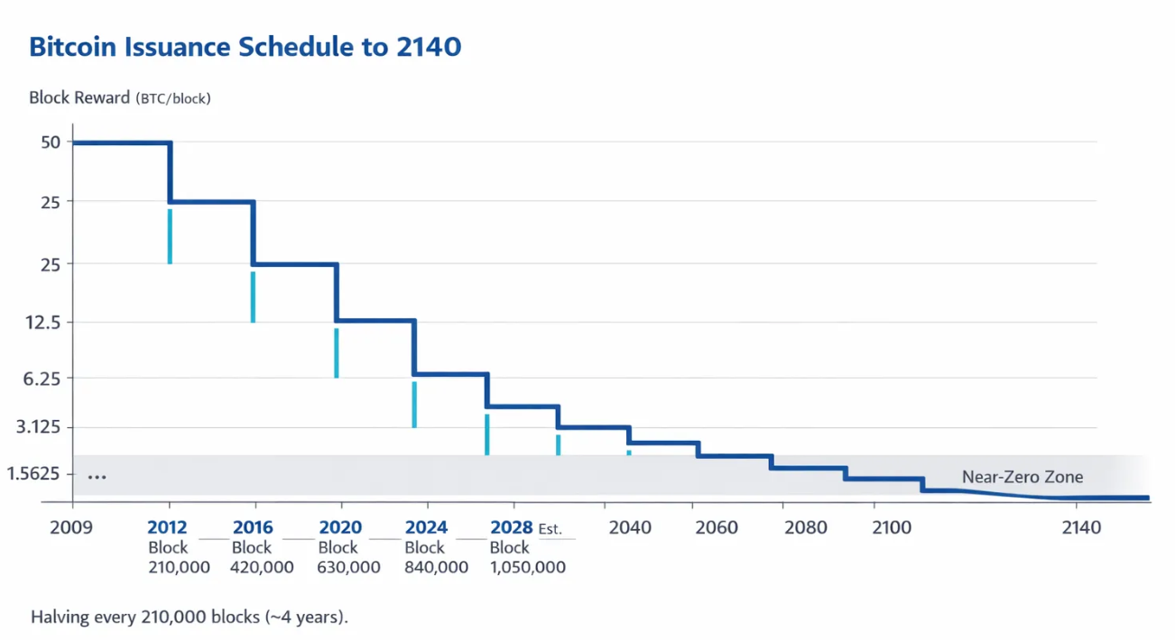
Bitcoin Rewards Per HALVING:

Slide 13
DIFFICULTY ADJUSTMENT:
PROBLEM!!!
The global mining lottery competition attracts more and more computing power which causes the random number puzzle in the blocks to be solved more quickly. If left unchecked, this would cause all the Bitcoin to be rewarded and distributed too soon.
Every 2016 blocks (about every 2 weeks), the network software measures the incoming rate of blocks and adjusts the difficulty in the puzzle. Increasing the difficulty requirement of the puzzle slows it down to always maintain a consistent block rate of about 10 minutes.
** The difficulty adjustment ensures the incoming rate of Bitcoin remains constant regardless of how many mining computers are on the network.

Slide 14
PROOF OF WORK:
The necessity of the mining process requires the use of raw computer processing power. Since all computers require it, the only way for the mining block validation process to occur is to consume physical electricity.
This material requirement is the essential tether between the digital and physical world. By requiring electricity for this process, the laws of physics CANNOT be bypassed which absolutely solidifies the security of the network.
Mining process cannot be ‘hacked’
Cannot be ‘cheated’ by a program, malware, or virus.
** Proof Of Work is the physical barrier mechanism for ensuring the security of the network

Slide 15
CONSENSUS:
The majority of the users agree to the same rules. Therefore, everyone that chooses to use the system MUST abide by the same rules. No exceptions!
Any change, enhancement, or modification to the system needs to be accepted and agreed to by the majority of the nodes. No CEO, billionaire, politician, or government can enforce or demand changes. Each node and Bitcoin user votes to determine which ruleset to use.
Every transaction and block must follow the agreed upon rules. Any deviation and that transaction is rejected by the network and NOT processed onto the chain.
Any change in the rules ceases to become Bitcoin and becomes something else. This leads to the creation of alternate (Alt) coins.
** The decentralized, secure, and unchangeable nature of the Bitcoin network makes it the most attractive ruleset to follow.

Slide 16
KEY BENEFITS OF THIS SYSTEM:
BORDERLESS:
  Globally exists via Internet. Country borders and government influences are ignored.
CENSORSHIP RESISTANT:
  No authority can stop or confiscate transactions. It is a direct transfer between addresses. Completely Peer to Peer. No third party involved.
OPEN SOURCE:
  No software code or rule is hidden. No fine print or unexpected surprises. All functionality of the ruleset is publicly available and auditable by anyone at any time.
PERMISSIONLESS:
  No barriers to join and use the system. No limits of age, gender, race, location, financial status, criminal background, political affiliation, credit score, etc…

Slide 17
KEY BENEFITS OF THIS SYSTEM:
VERIFIABLE:
  At any moment, it is possible to verify the entire amount that exists and ever will exist. The entire transaction history is available on every node.
TRANSPARENT:
  Nothing is hidden. All rules and functionality are fully available to anyone at any time.
LIMITED FIXED SUPPLY:
  The agreed rules enforce a maximum supply of 21 million coins. This amount CANNOT be changed.
  This enforcement challenges the core economic principles of supply and demand. The supply for “sale” can change per the market, but the underlying supply of the asset is completely fixed.

Slide 18
A BITCOIN Standard:
Bitcoin solves the inflation problem because it is a monetary technology that CANNOT be expanded or artificially created.
Its unique properties create a new form of money that establishes an unchangeable fixed denominator that satisfies the requirements of sound money.
Most things in this world are measured by a standard agreed upon unchanging unit:
  Centimeter for length
  Hour for time
  Temperature to measure heat
Bitcoin is the first time in human history where we can now apply a standard fixed universal unit to measure economic value that cannot expanded, changed, or modified by some government, monarchy, elite group, or corrupt leader.
Money is not a hedge against monetary inflation. It is the cure.

Slide 19
COMMON KEY FACTS:
Hard capped fixed supply of 21 million Bitcoin
Bitcoin took over 20 years of research, trial and error, and failed attempts to create a purely decentralized internet monetary system.
Released by anonymous author: Satoshi Nakamoto. His concealed identity was critical in the success of Bitcoin to avoid a central authority or a single person having undue influence.
1 Bitcoin can be divided into 100,000,000 units called “Satoshis”.
Satoshis are equivalent to cents to a dollar. Same underlying substance, different denomination. (95 cents = .95 dollars) (500,000 Satoshis = .005 BTC)
Can purchase and transact in Satoshis. Don’t fall for unit bias!
Loss of a wallet or access to a wallet (private key) results in losing the ability to create a transaction. If BTC cannot be sent, then it effectively becomes useless and is considered lost.

